Slide 1
Lisbon Regional School Safety Assembly
September 20, 2018
Grades 7-12

Slide 2
Why are we here today?
To discuss simple steps to keep you safe that need to be taken if there was ever an active shooter or intruder situation.

Slide 3
How is ALICE different from other drills?
ALICE (Alert, Lockdown, Inform, Counter, Evacuate) training helps prepare individuals to handle the threat of an Active Shooter. ALICE teaches individuals to participate in their own survival, while leading others to safety. Though no one can guarantee success in this type of situation, this new set of skills will greatly increase the odds of survival should anyone face this form of disaster.
Lockdown is no Longer Enough
Multiple Options are needed
Those in Harm’s Way Should Make Their Own Decisions

Slide 4
Waltham high school Video
Waltham High School ALICE videO
https://www.youtube.com/watch?v=CqkUw9egsWc

Slide 5
What does A.L.I.C.E. stand for?
ALICE is a comprehensive training program for increasing the chances of survival through proactive response options during a Violent Critical Incident.
A-Alert
L-Lockdown
I-Inform
C-Counter
E-Evacuate

Slide 6
Shooting Statistics
Virginia Tech University
  9 minutes
  47 total victims
    30 killed
    17 injured
Northern Illinois University
  6 minutes
  27 total victims
    6 killed
    15 injured

Slide 7
Shooting statistIcs
Columbine High School
  17 minutes
  37 Total victims
    13 killed
    24 injured
  6 minutes of this rampage in the library resulted in 12 injured and 10 dead
Sandy Hook Elementary School
  5 minutes
  28 Total Victims
    26 killed
    2 injured
  Additional death – Lanza’s mother prior to rampage

Slide 8
What is ALICE?
Addresses violent intruders
Maximizes survivability of targets through options
Teaches how to help wounded/injured

Slide 9
Why ALICE?
Begin the mental preparation to:
  Recognize
  Assess
  Respond
To threats against you and/or other members of the SCHOOL community
Active Shooter/intruder scenarios happen everywhere

Slide 10
Benefits of ALICE
Provides Options for maximum survival
Provides Knowledge
  Persons under attack can make informed decisions
Empowers faculty, staff and students to DO something instead of waiting to be a victim/casualty

Slide 11
ALICE
ALERT

Slide 12
ALERT
Information is the key to making good decisions
  Use plain English
  Give as much information as possible
    What is the person wearing
    where were they last seen?

Slide 13
ALICE
LOCKDOWN

Slide 14
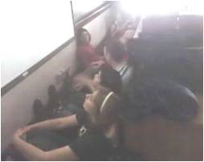
Lockdown
Traditional Lockdown Procedure
Shut and lock door
  Turn off the lights
  Sit in the corner
Is this a sufficient, stand-alone, mandated defense?

Slide 15
Lockdown
Starting point, but not the only point
Part of the process, but does not stand alone
Lockdown procedure (PLUS)
  Barricade door
  Spread out within the room
  Do not huddle
  Look for alternate escape routes (other doors or windows)
  DO NOT open door for anyone
  Dial 911 when safe to do so

Slide 16
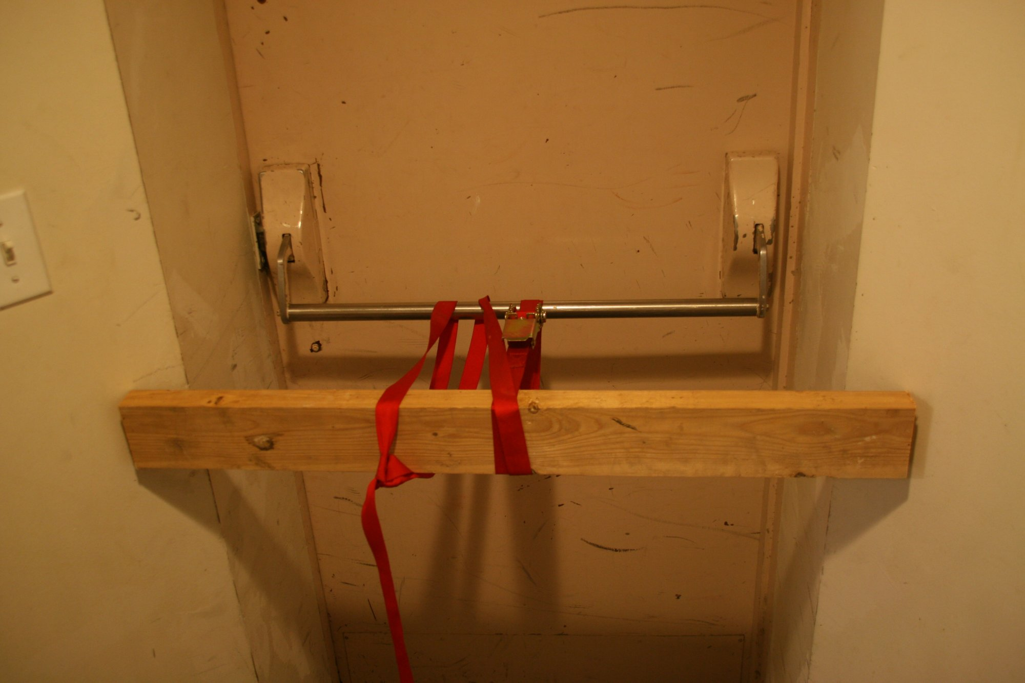
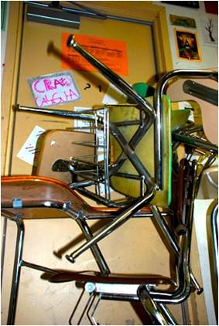
Barricades

Slide 17
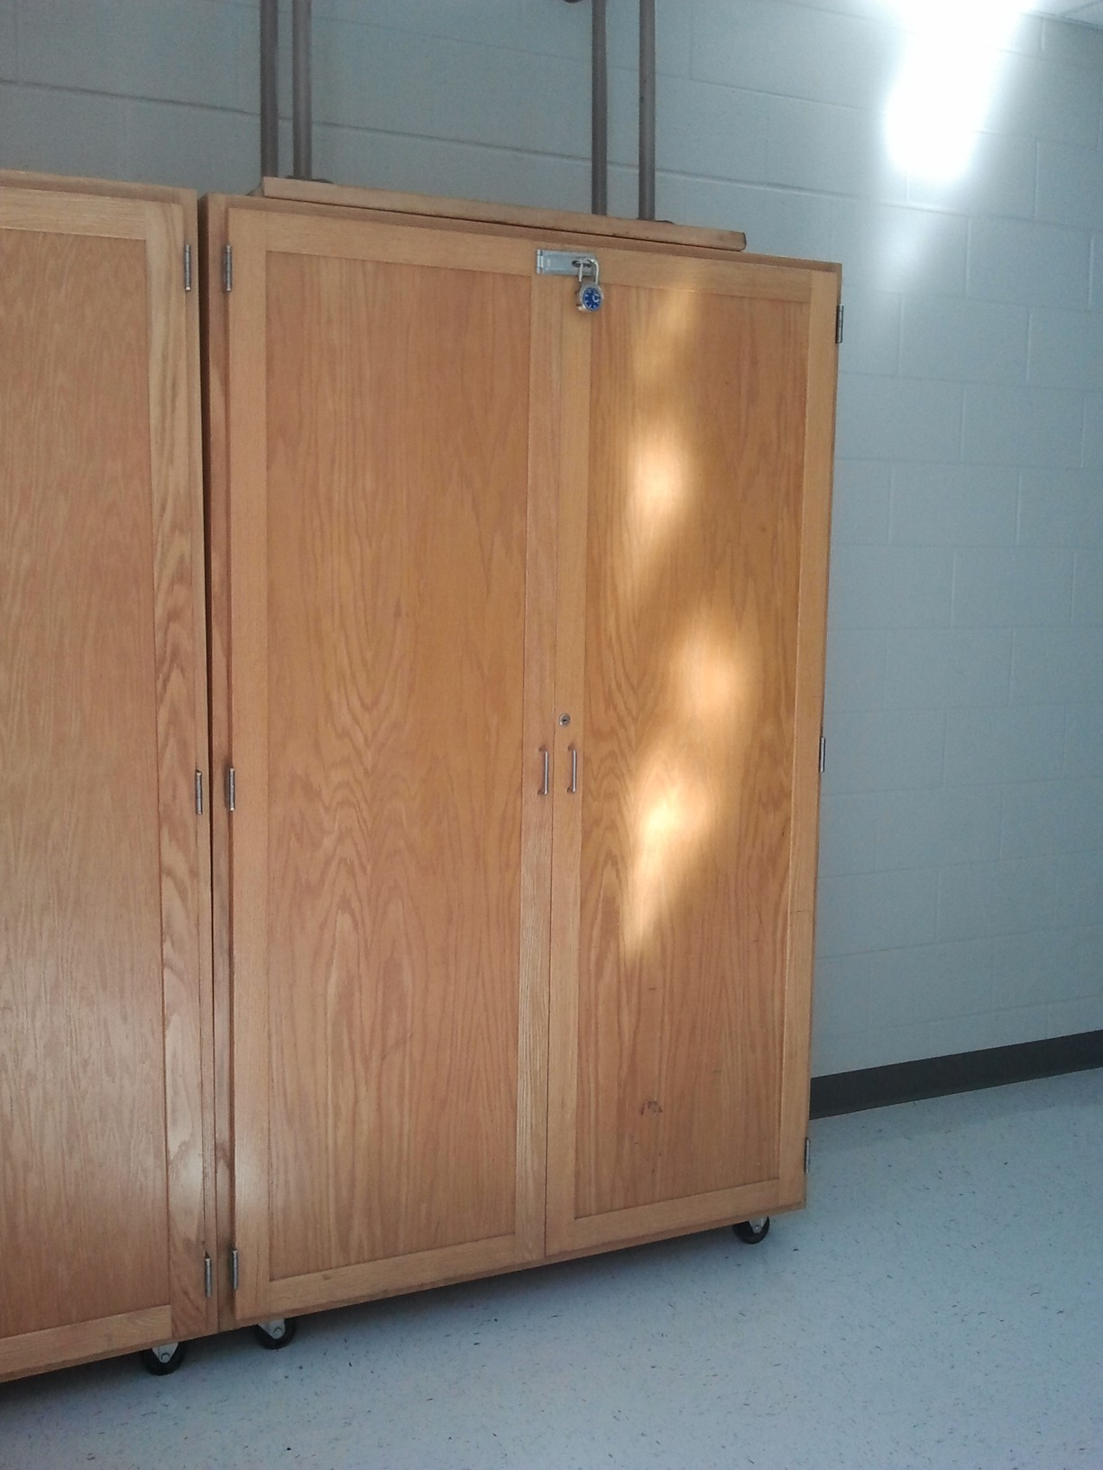
Barricades
What items in YOUR classrooms can be used to barricade the door?

Slide 18
ALICE
INFORM

Slide 19
Inform
Empower staff and students
Methods of getting information
Pass on real time detailed information
  WHERE IS THE INTRUDER?
  What are they wearing?
Continuation of ALERT

Slide 20
ALICE
Evacuate

Slide 21
EVACUATE
Escape – the preferred response
Only 2% of active shooter/intruder scenarios have involved more than one perpetrator
If intruder is inside, get outside
Do not use a car to evacuate
Rally Points and Reunification points should be established
  Middle School and high school students go to the offsite location
  Remove as many potential targets as you can

Slide 22
How to Evacuate
Run with your hands up (for police)
  Do not have your phone in your hand
Climb out/jump out windows
Assist others in evacuation

Slide 23
ALICE
counter

Slide 24
Counter
When all else fails
  If you are unable to evacuate or escape
    The intruder has broken through the barricade
    The intruder entered the room before you had the chance to barricade

Slide 25
COUNTER
Police miss 70-80% of their shots in dynamic events
Active shooters are typically not highly skilled shooters
Take Counter steps
  Interrupt the process of shooting
  Create a distraction
    Shout
    Throw things
    swarm
  DO NOT Sit quietly on the floor and wait to become a victim

Slide 26
COUNTER
If you can knock the weapon away, put it in or under a trash can or other area.
  Do not hold the weapon over the shooter
  Do not hold the weapon in your hands

Slide 27
ALICE
Survival

Slide 28
SURVIVAL
Preparation is the key
  Be careful how and what you practice
  We must prepare as if it will happen and at a level that reflects reality
TO SURVIVE be prepared:
  Physically
  Mentally
  Equipment Ready

Slide 29
Drills we will have
Secure campus
Shelter-in-place
Lockdown
Evacuation
Reverse evacuation

Slide 30
Secure campus
  Protects the students and staff from a threat outside the building
    Close windows and shades
    Make sure doors are locked
    Reduce/eliminate movement in the hallways
    Continue normal academic activities
    Cancel outdoor activities

Slide 31
Shelter-in-place
Protects students and staff from external airborne hazardous materials
  Close windows
  Turn off heating/air conditioning fans and equipment
  Close vents
  Cover vents with duct tape and plastic

Slide 32
lockdown
Protects students and staff from a violent intruder or other situation that would require students and staff to be in an area that can be locked
  Move to an area that can be secured
  Close and lock doors and windows
  Barricade doors and windows
  Shut off lights
  Evacuate, if safe to do so and as deemed appropriate
  Stay aware if fire alarm sounds, be prepared to evacuate

Slide 33
evacuation
Protects students and staff from a hazard (fire/chemical spill) in the building
  Initiated by the fire alarm
  Exit through the nearest and safest exit
  Gather at the designated meeting area
  Staff will take attendance, await further instructions

Slide 34
Reverse evacuation
Protects students and staff from a potentially dangerous situation outside the building
  Initiated by a staff member blowing a whistle three times
  Students go to the teacher for instructions
  Everyone enters the building and attendance is taken
  Remain quiet and await further instructions

Slide 35
KEY THINGS TO REMEMBER FROM THIS PRESENTATION
LISTEN to The teacher/adult in room, if applicable (if they tell you to run, run!)
Don’t look for an adult to go to if your instinct tells you to run and there is not adult in sight
Be Sure Your Hands are Up and empty when exiting the building
Leave everything where it is (it’s not worth your life!)
Phone etc. in pockets (so the police know you don’t have anything that could be mistaken for a weapon)
Ultimate destination is the offsite location
Even if you have a car or live nearby, you must go to the church (for accountability)

Slide 36
IN a moment of decision, the best thing you can do is the right thing, the next best thing is the wrong thing, the worst thing you can do is nothing.
Theodore Roosevelt

Slide 37
Next steps
Off site Evacuation Drill will be on September 25th from 9:45-10:50 am
At this time students will now report to their class meeting advisor’s room for a short debrief of today’s assembly
  7th grade – mr. weaver (room 217)
  8th grade – mrs. Williams (room 216)
  9th Grade-Mr. Wood (Room 205)
  10th grade- mr. superchi (room 200)
  11th grade- mrs. Locke (room 113)
  12th grade- mrs. Clark (room 108)

